Slide 1
Lab 2: Execution Unit
Microprocessors CMPS-201

Slide 2
Contact information
TA: Eng. Omar Amer
Email: omartarekamer@gmail.com
TA: Eng. Moustafa Ghouneem
Email: mostafamahmoud86@eng.cu.edu.eg

Slide 3
Today we will learn:
What are we doing?
How does this lab and the previous one relate to the curriculum?
What does a real microprocessor look like?
What is the execution unit?
Useful ICs to help you with the lab.

Slide 4
What are we doing?

Slide 5
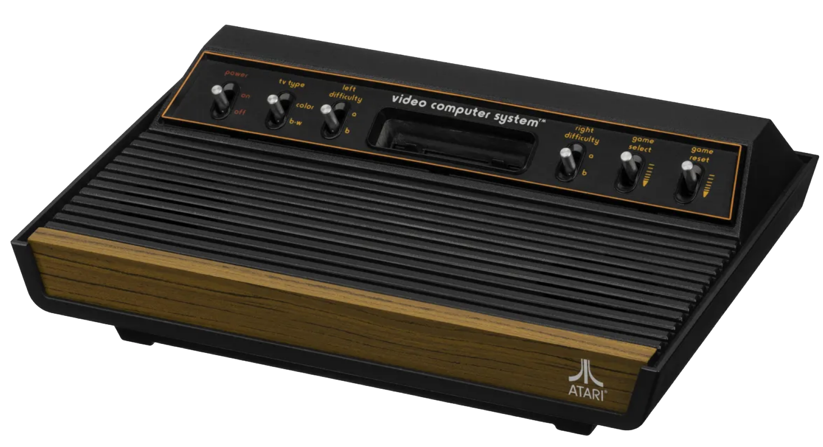
What is this?

Slide 6
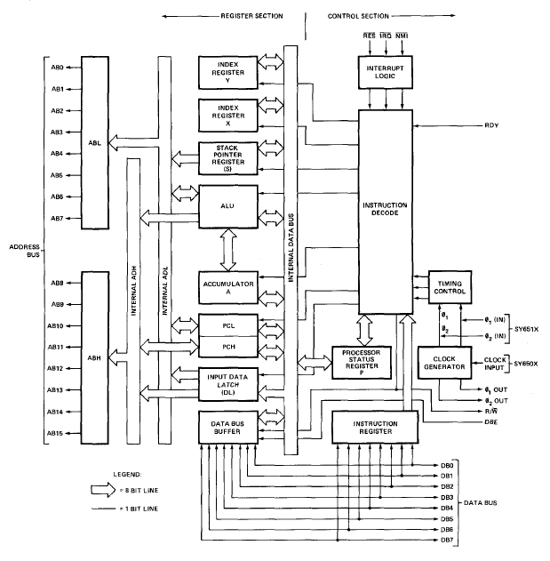
The 6500
Notes:
This was the first truly affordable microprocessor.

Slide 7
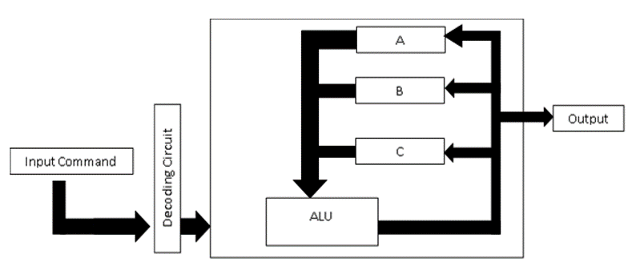
Our microprocessor
A format of input instructions (commands).
Instruction decoding circuit (We must know where to read and write based on the instruction alone)
A group of registers. (For R/W)
Your ALU from the last lab.

Slide 8
1 Instructions
Before starting to design any processor, one must know what operations this processor will perform.
This is managed by the ALU (Lab 1)
In addition to the operations, one must also know what addressing modes the processor will have.
This is managed by the instruction decoding circuit.
We will have only two addressing modes:
Immediate addressing mode.
Register addressing mode.
Notes:
Immediate: From a number in the instruction to a register. Example: MOV AX, 1234H
Register: From on register to another. Example: MOV AX, BX

Slide 9
1 Instructions
MOV CX, BX
Register addressing mode.
MOV AX, 1234H
Immediate addressing mode.

Slide 10
1 Instructions
Each of these instructions are nothing but bits.
The MOV CX, BX command for example,
The assembler turns the command into bits such that the instruction decoding circuit knows:
What operation to choose from the ALU (In this case, we choose to pass BX).
What operands to choose for the ALU (Since we will pass BX, BX must be an operand of the ALU. We don’t care about the other operand)
Where to store the result (The first register is the destination register in the 8086, store the result in CX).

Slide 11
1 Instructions: Suggestion
opCode, dst, src, imm
Notes:
How many bits for the opcode, src, dst, and imm ?
How long is our instruction?
If we are doing a reg2reg operation, what happens to the imm ?

Slide 12
2 Decoding Circuit
The execution unit will have three operations
ADD
MOV
XNOR
And two addressing modes
Register
Immediate

Slide 13
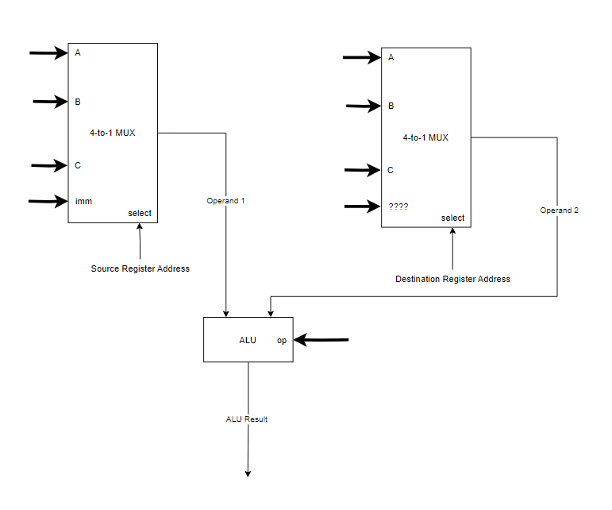
2 Decoding Circuit

Slide 14
Stop here and think
Where do we get the inputs of the ALU?
How many inputs should the ALU have? How wide are they?
Where does the result of the ALU go?

Slide 15
3 The register file
A bunch of registers grouped together is called a “register file”
Inputs: write_data, write_address, (what else?)
We need to read and write to and from each register.
We have three registers (A, B, and C).
How many bits do we need to address each register?

Slide 16
Helpful Blocks in Quartus
You will need these blocks for the lab.

Slide 17
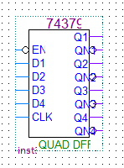
1 The register
How wide should the registers be?
The 74379 IC is a QUAD FF, which means it is four-bit register.
The enable signal is active low (what does this mean)?

Slide 18
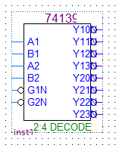
2 The decoder
The 74139 IC is a dual 2-to-4 decoder. We only need to use one decoder.
Also has active low enable signals for both decoders.
Inverting outputs. (like a normal decoder, but with a NOT gate after each output).

Slide 19
Lab requirements
Time for you to shine

Slide 20
Lab 2 requirements
Build the execution unit.
Move Value to Register
Move Register to Register
Add Value to Register
Add Register to Register
XNOR Value to Register
XNOR Register to Register
Assemble this program
Simulate this program and use the waveform to verify your design.
MOV A, Ah
MOV B, Fh
ADD A, B
MOV C, 6h
XNOR C, A
MOV A, B
AND A, 0h

Slide 21
Lab 2 requirements
Execution Unit
Inputs
Instruction (how wide?)
Clock
Outputs
Values of registers A, B, and C.

Slide 22
Any questions?
“There are no foolish questions and no man becomes a fool until he has stopped asking questions.” – Charles Proteus Steinmetz

Slide 23
Hints
Create a new project, copy all the .bdf and .bsf files from the last lab to the new project.
Four-bit register => 74379
Dual 2-to-4 decoder => 74139
Any small change requires a save and compile. (Ctrl+S , then Ctrl+L)
For the waveform, apply the values on the negative edge of the clock.

Slide 24
Time to work
Move Value to Register
Move Register to Register
Add Value to Register
Add Register to Register
XNOR Value to Register
XNOR Register to Register
MOV A, Ah
MOV B, Fh
ADD A, B
MOV C, 6h
XNOR C, A
MOV A, B
Waveform
Notes:
Remember to take attendance.

Slide 25
Thank you.

